Slide 1
Towards Deep Learning Models Resistant to Adversarial Attacks
Yan Han
Gautam Krishna

Slide 2
Adversarial Input
Alexnet
Dog
Dog
Dog with modified ear shape, tail shape
Monkey
Adversarial Input
Why ?

Slide 3

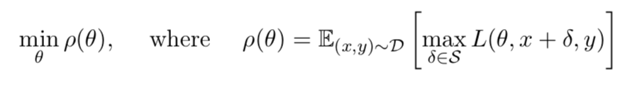
Optimization View on Adversarial Robustness
Find model parameters so that the adversarial loss given by the inner attack problem is minimized
Find an adversarial version of a given data point x that achieves a high loss.
training a robust classifier using adversarial training
1. Propose a concrete guarantee that an adversarially robust model should satisfy
2. Then adapt training methods towards achieving this guarantee
Specify an attack model
For each X introduce a set of allowed perturbations
adversary to perturb the input first
Notes:
Attack Model : precise definition of the attacks our models should be resistant to .

Slide 4
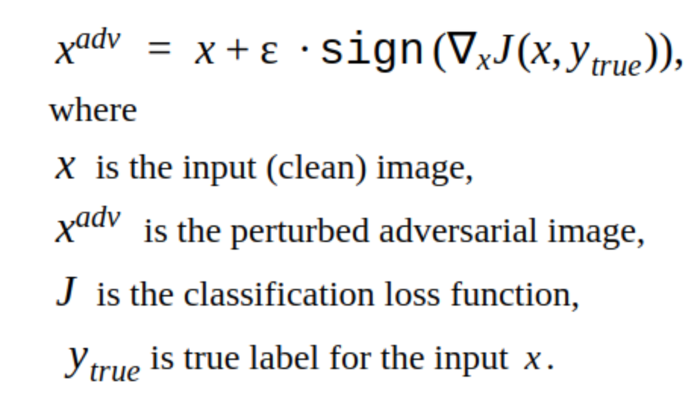
Fast gradient sign method (FGSM)
Epsilon is a small number controlling the size of adversarial attack
Defense ??

Slide 5
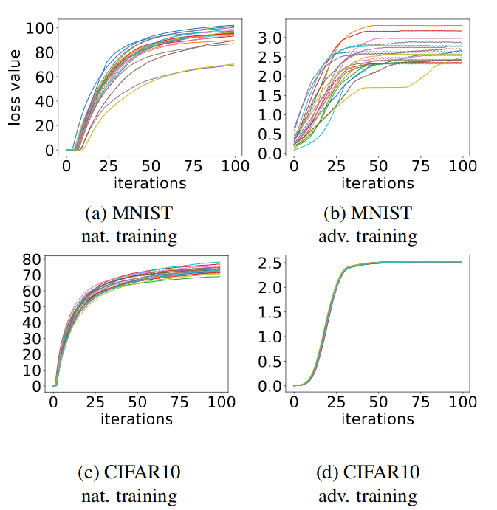
Value of loss function over PGD iterations

Slide 6
First-Order Adversaries
If a network is trained to be robust against PGD(universal) adversaries, it will be robust against a wide range of attacks
The local maxima found by PGD all have similar loss values, both for normally trained networks and adversarially trained networks
MNIST and CIFAR10 evaluation datasets
Robustness guarantee would become even stronger in the context of transfer attacks
attacks in which the adversary does not have a direct access to the target network

Slide 7
Network Capacity and Adversarial Robustness
Final loss achieved against adversarial examples should be very small
Guarantees performance of the classifier
Ideally we want a perfect classifier, which is robust to adversarial inputs
Their experiments verify that capacity is crucial for robustness, as well as for the ability to successfully train against strong adversaries ( in particular for smaller values of ε)
FGSM adversaries don’t increase robustness (for large ε)( Label leaking)
Weak models may fail to learn non-trivial classifiers

Slide 8
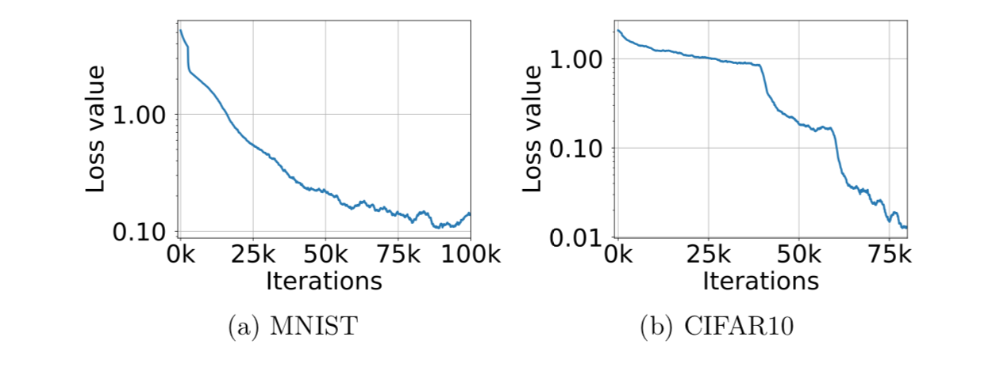
Experiments: Adversarially Robust Deep Learning Models
Goal
train a sufficiently high capacity network
use the strongest possible adversary
PGD adversary

Slide 9
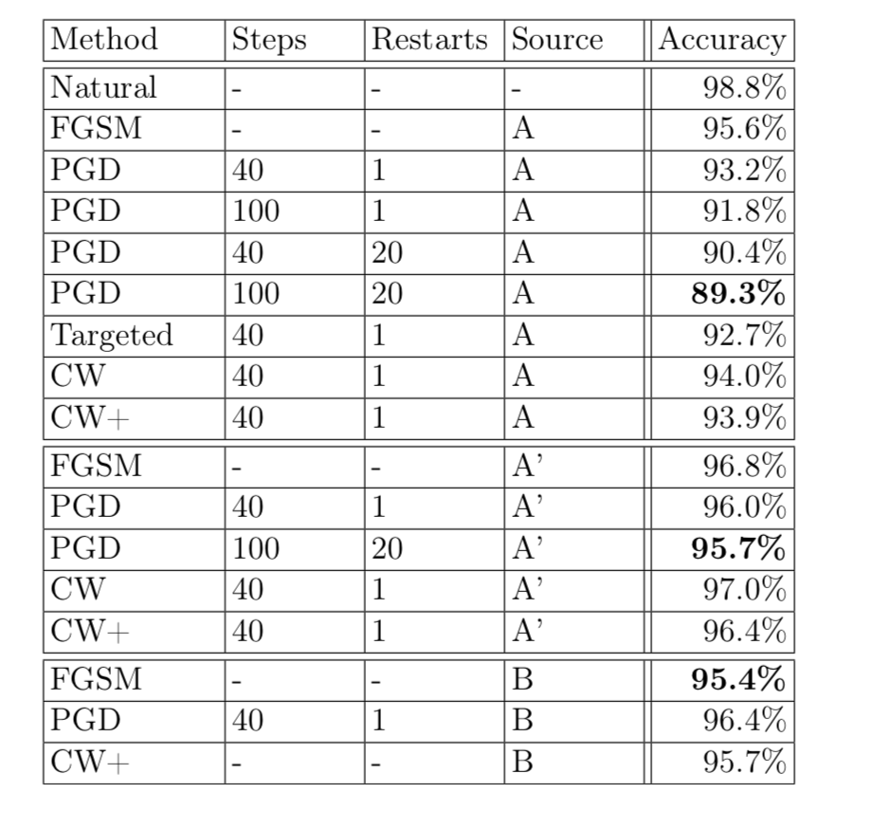
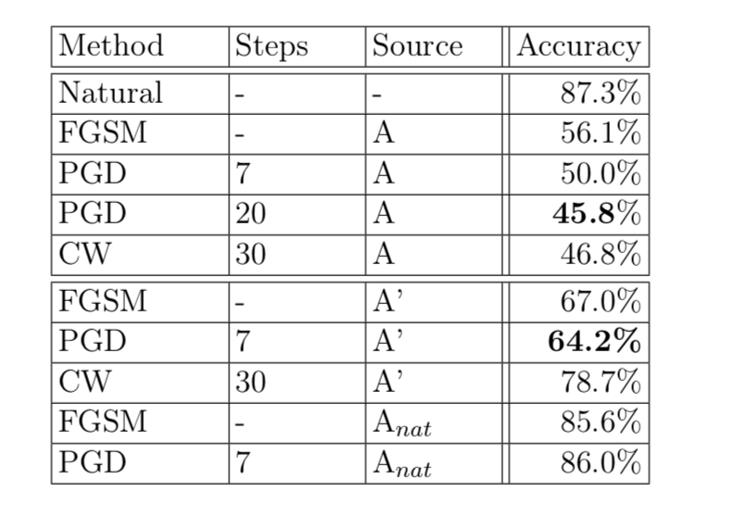
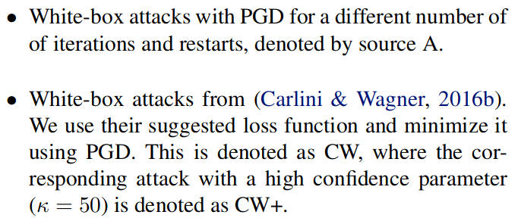
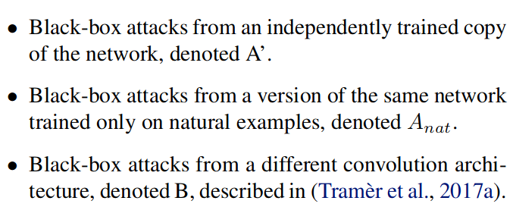
Results
MNIST: Performance of the adversarially trained network against different adversaries for ε = 0.3
CIFAR10: Performance of the adversarially trained network against different adversaries for ε = 8

Slide 10
CONCLUSION
Demonstrated good performance for MNIST Data Set
Demonstrated poor performance for CIFAR 10 Data Set

